Slide 1


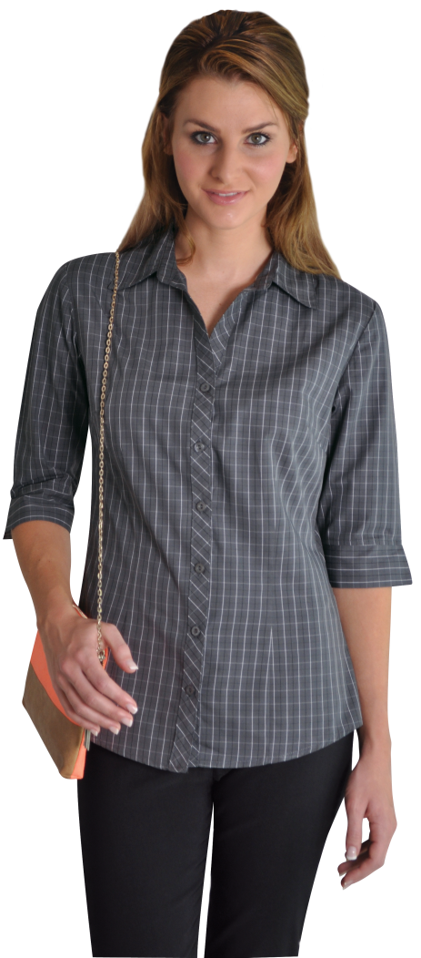



MOTOR INDUSTRY UNIFORMS

